Slide 1










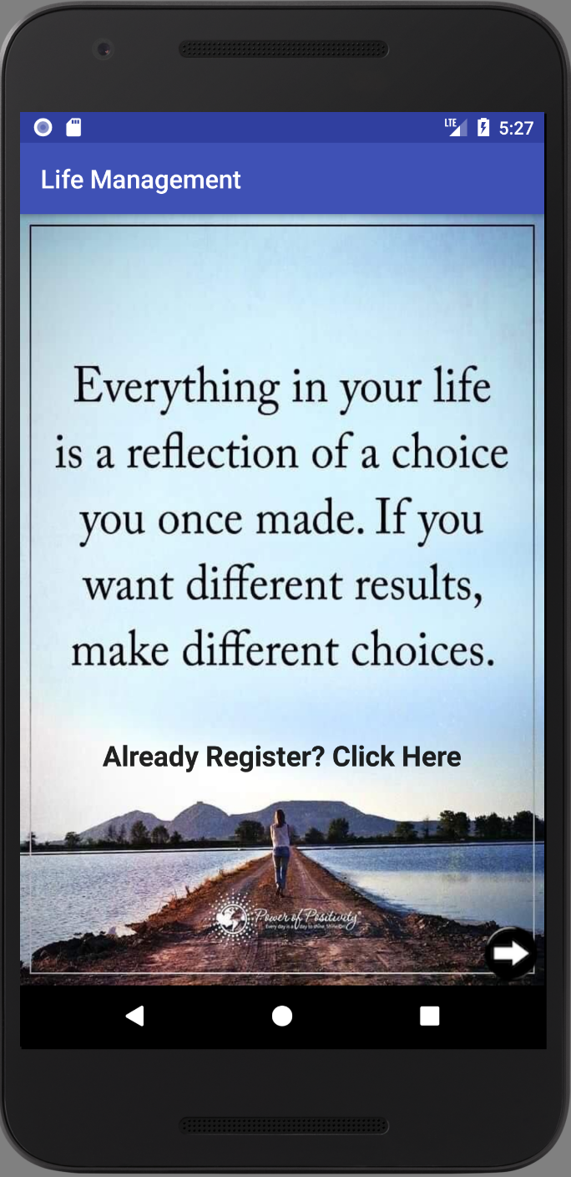
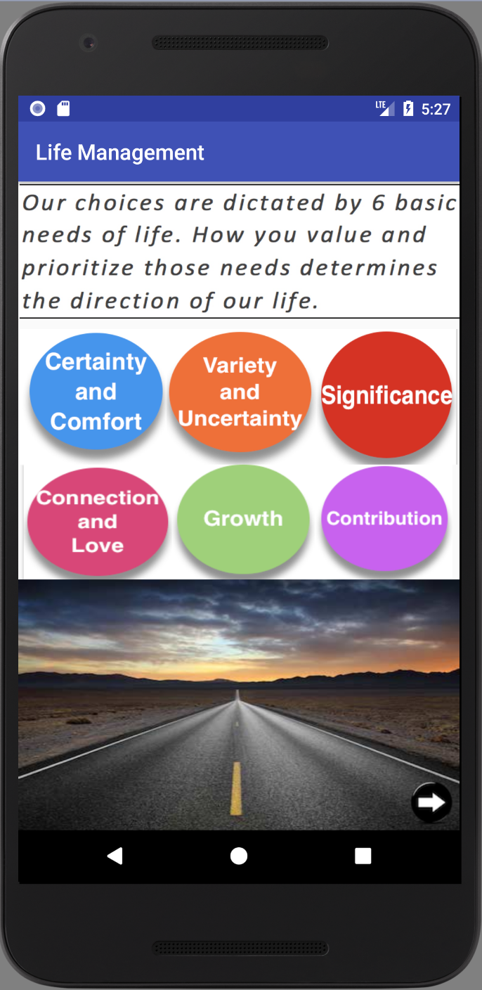
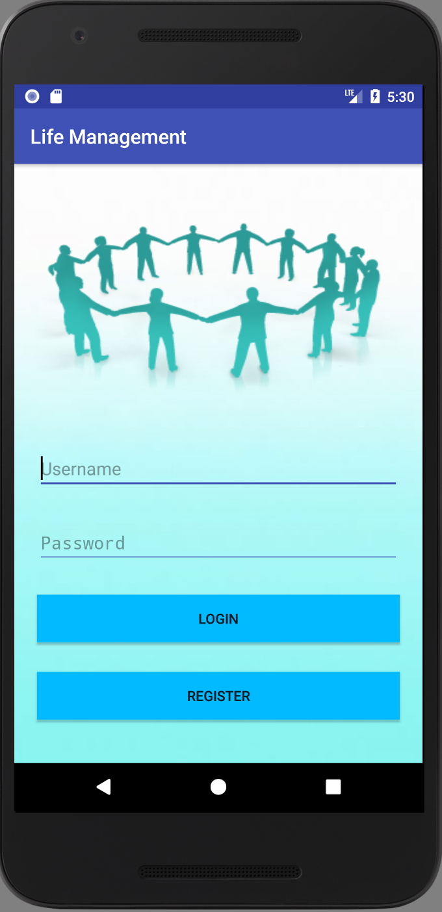
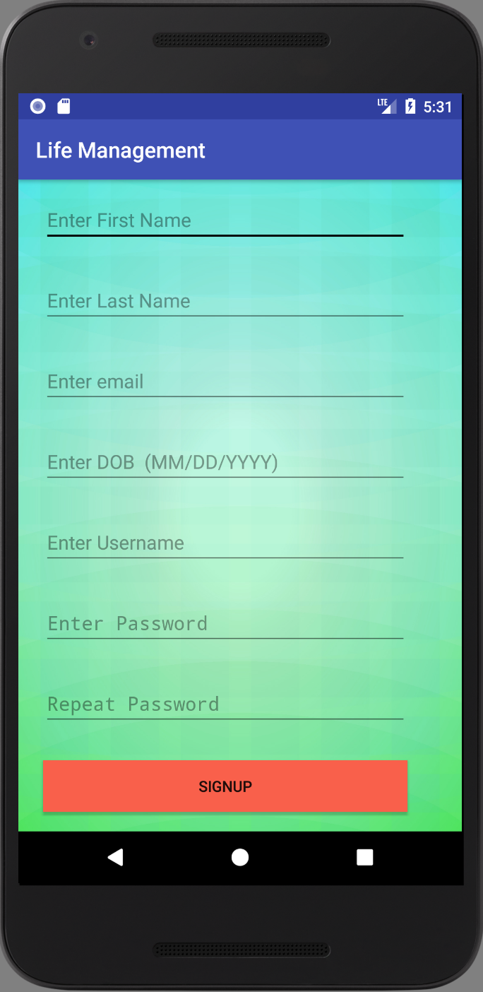
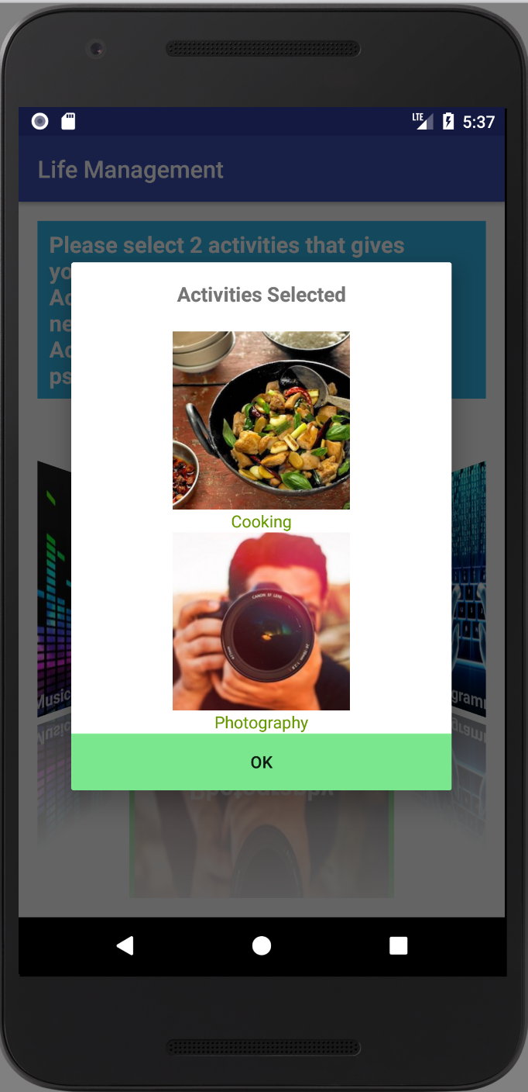
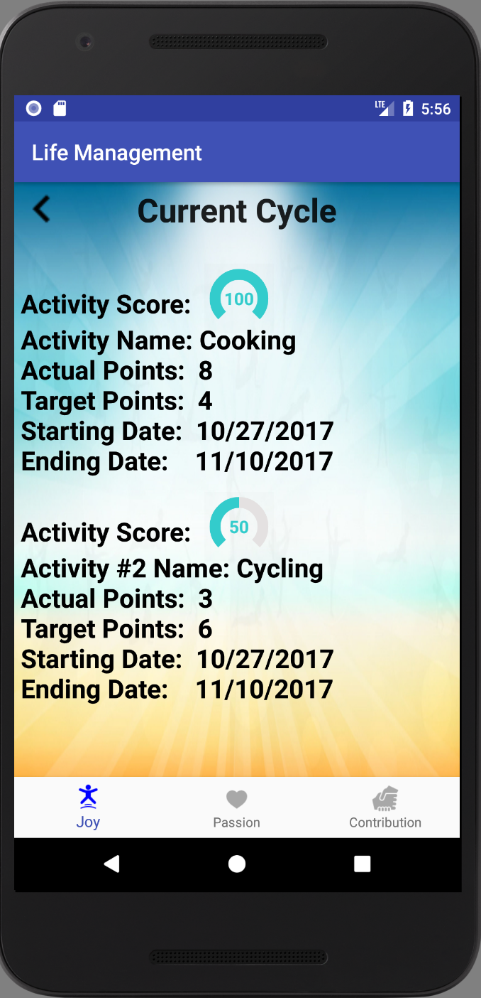
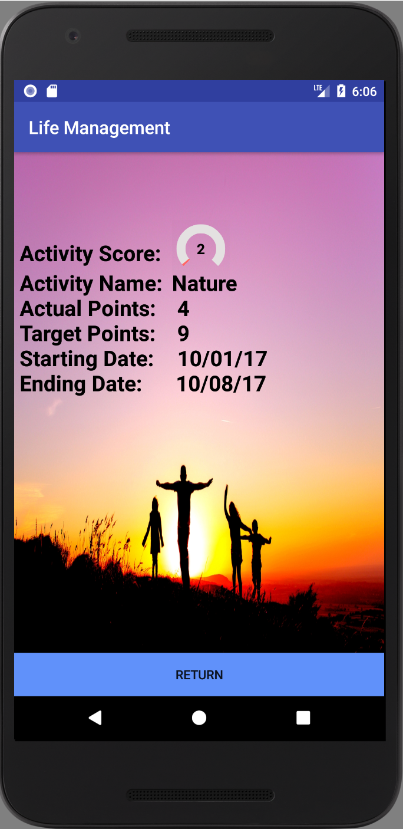
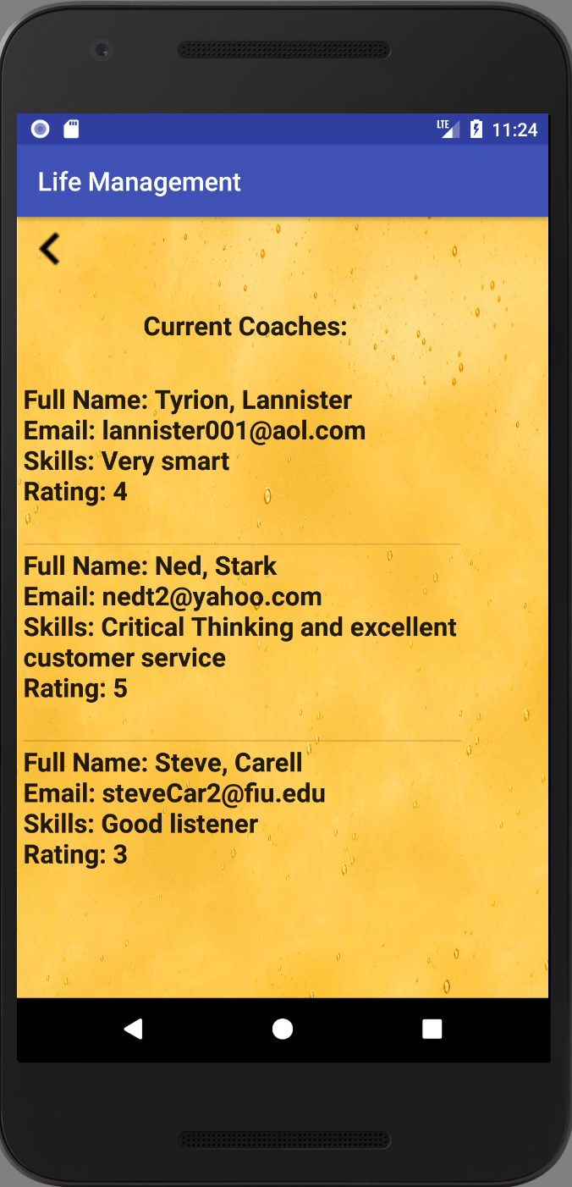



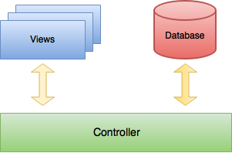
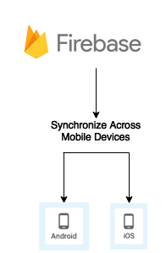

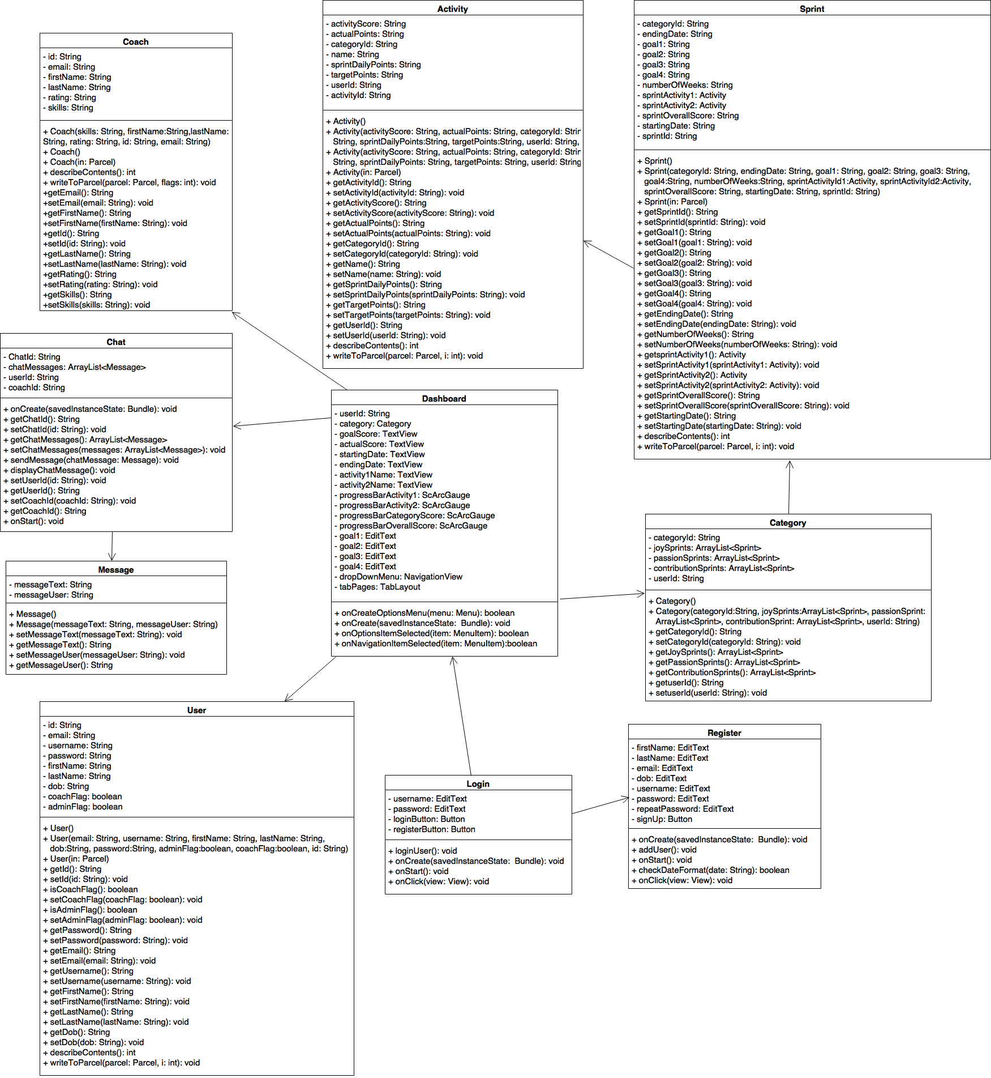


School of Computing & Information Sciences
Senior Project, 2017, Fall
Life Management 2.0
Student: Lazaro Fernandez, Florida International University
Mentor: Ranjeet Deshmukh, CrossMatch
Professor: Masoud Sadjadi, Florida International University
Problem
Solution
Current System
Social Media obsession makes life unorganized.
Many people lack purpose and happiness in their life.
People need help in finding what they want to achieve.
Android application to manage daily activities and track progress throughout the time.
A place to contact Life coaches for guidance and fulfillment.
An application that helps you reach your goal by doing what you like.
Help users reach their goals in life.
Provides an application to keep track of daily progress.
Allows users to see available Life coaches.
Allows users to maintain a positive focus in life no matter what’s going on around them.
1- Initial Landing Page. Users can continue as a guest or go directly to login if they are registered.
2- Second Screen. Allows the user to understand the purpose of this app.
3- Login Screen. Users are abled to login using their username and password.
4- Sign Up Screen. Users can create an account by providing the above information.
5- Activity selection. Users can select 2 activities for Joy, Passion and Contribution.
6- Current Cycle Screen. Users can view their current cycle for Joy, Passion and Contribution.
7- Previous Cycle Screen. Each previous cycle contains the above information.
8- Coaches Screen. Users can see all the coaches that are currently available in the system.
Requirements
System Design
Implementation
Users can navigate the initial landing page (Pic 1).
Users can read and understand the purpose of the application (Pic 2).
Users can login to the app using their credentials (Pic 3).
Users can create an account (Picture 4).
Users can choose 2 activities for Joy, Passion and Contribution when they create a new cycle (Pic 5).
Users can view their current cycle (Pic 6).
Users can view their previous cycles for Joy, Passion and Contribution (Pic 7).
Users can view current Coaches. (Pic 8).
The application was implemented in Android Studio Version 2.3.3, using Java, XML and Android Development Kit (SDK).
Firebase was used as our database to store all the data.
Agile organizational approaches in Mingle.
Object Design
Summary
People are getting more addictive to social media.
Technology is causing people to lose their direction in life.
This app allows the users to plan and perform activities that gives them Joy, Passion and Contribution, allowing them to succeed in life.
This solution allows users to contact Life Coaches for better guidance.
Verification
Test Case ID: | Unit_previousCycle_001_001
Description: | Testing if the previous cycles shown are the ones for that user.
Preconditions: | User must be logged-in and in Dashboard screen.
Input: | User clicks on ‘View Previous Cycle’ button.
Expected Output: | A list of all previous cycles for that user is shown. (Each list contains: Name of activity, starting date and ending date)
Acknowledgement
The material presented in this poster is based upon the work supported by Natalia Filippova. I am thankful to the help that I received from my group member Eric Rado, our mentor Ranjeet Deshmukh and contributor Ravi Kiran.
Notes:
1

